Slide 1





Slide 2
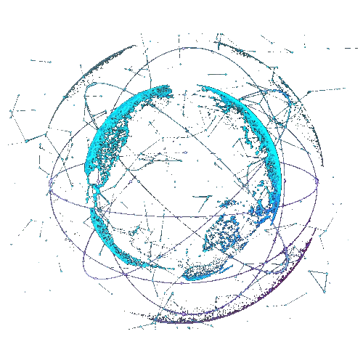


Slide 3
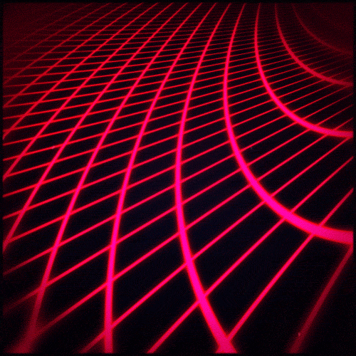

Slide 4
melab BD

Slide 5

melab BD

Slide 6
@melabBD

Slide 7



melab BD

Slide 8
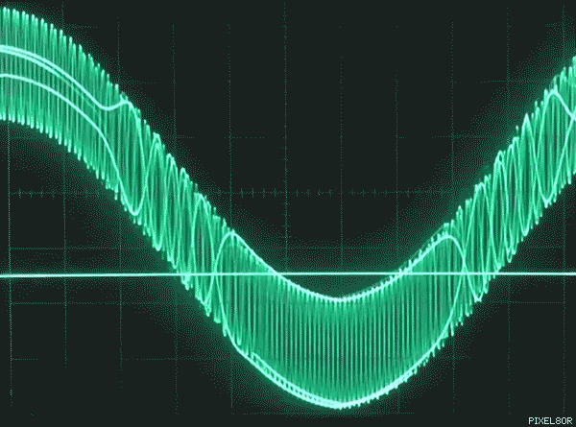
melab BD

Slide 9
melab BD

